Slide 1
Machine Learning
BE Sixth Semester 20CS610

Slide 2
Course Outcomes
After completing this course, students should be able to:
CO1: Understand the basic concepts of Machine Learning.
CO2: Formulate machine learning problems corresponding to different applications.
CO3: Understand the unsupervised learning techniques..
CO4: Understanding the pre-processing activity done for Machine learning algorithm.
CO5: Understand neural networks implemented for various applications.

Slide 3
Text Books
Pattern Recognition and Image Analysis, Earl Gose,
Richard Johnsonbaugh Steve Jos, Pearson 2015
Pattern Classification, Richard O. Duda, Peter E. Hart, David G. Stork, Second edition, Wiley publication.
Ethem Alpaydin (2014). Introduction to Machine Learning, Third Edition, MIT Press. The textbook website is https://www.cmpe.boun.edu.tr/~ethem/i2ml3e/

Slide 4
Reference Books
1. Machine Learning, Tom M. Mitchell, McGraw-Hill Publishers, 1997.
2. Pattern Recognition and Machine Learning, Christopher M. Bishop, Springer Publishers, 2011.
3. Kevin Murphy, Machine Learning: A Probabilistic Perspective, MIT Press, 2012.
4. Understanding Machine Learning , Shai Shalev-Shwartz and Shai Bendavid, Cambridge University press. 2017.

Slide 5
Assessment Weightage in Marks
Class Test –I 10
Quiz/Mini Projects/ Assignment/ seminars 10
Class Test – II 10
Quiz/Mini Projects/ Assignment/ seminars 10
Class Test – III 10
Total 50

Slide 6
Question Paper Pattern
Semester End Examination (SEE)
Semester End Examination (SEE) is a written examination of three hours duration of 100 marks with 50% weightage.
Note:
• The question paper consists of TWO parts PART- A and PART- B.
• PART- A consists of Question Number 1-5 are compulsory
(ONE question from each unit)
• PART-B consists of Question Number 6-15 will have internal choice.
(TWO question from each unit)
• Each Question carries 10 marks and may consist of sub-questions.
• Answer 10 full questions of 10 marks each

Slide 7
UNIT – 1 Introduction & Bayesian Decision Theory:
Introduction: What Is Machine Learning? Applications of Machine Learning, Types of Machine Learning, Statistical Decision Theory and Analysis
Probability: Introduction, Basics of Probability, Combination, Permutation, union, Intersection. Complement, Conditional Probability, Random Variables, Binomial Distribution, Normal distribution, Joint Distributions and Densities, Moments of Random Variables

Slide 8
Machine Learning – Unit 1

Slide 9
Introduction
Artificial Intelligence (AI)
Machine Learning (ML)
Deep Learning (DL)
Data Science

Slide 10

Artificial Intelligence
Artificial intelligence is intelligence demonstrated by machines, as opposed to natural intelligence displayed by animals including humans.

Slide 11
Machine Learning
Machine Learning – Statistical Tool to explore the data.
Machine learning (ML) is a type of artificial intelligence (AI) that allows software applications to “self-learn” from training data and improve over time, to become more accurate at predicting outcomes without being explicitly programmed to do so.
Machine learning algorithms use historical data as input to predict new output values.
Machine learning algorithms are able to detect patterns in data and learn from them, in order to make their own predictions
If you are searching some item in amazon… next time… without your request… your choice will be listed.

Slide 12
Deep Learning
It is the subset of ML, which mimic human brain.
Three popular Deep Learning Techniques are:
ANN – Artificial Neural Network
CNN- Convolution Neural Network
RNN- Recurrent Neural Network

Slide 13
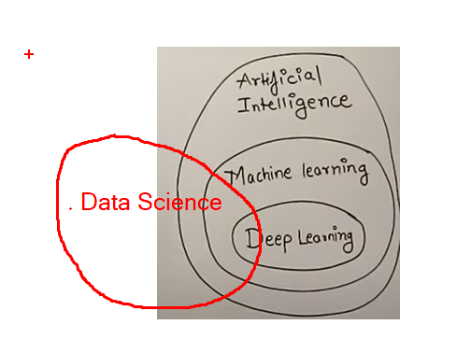
Summary:

Slide 14
What is Machine Learning?
Learning : is any process by which a system improves performance from experience.
Example: We call experienced doctor, Experienced Teacher, Experienced driver
Machine Learning is the study of algorithms that
• improve their performance P
• at some task T
• with experience E.
A well-defined learning task is given by <P,T,E>

Slide 15
Defining the Learning Task
Improve on task T, with respect to performance metric P, based on experience E
T: Recognizing hand-written words
P: Percentage of words correctly classified
E: Database of human-labeled images of handwritten words
T: Driving on four-lane highways using vision sensors
P: Average distance traveled before a human-judged error
E: A sequence of images and steering commands recorded while observing a human driver.

Slide 16
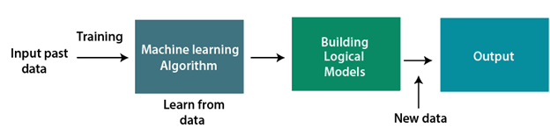
A Machine Learning system learns from historical data, builds the prediction models, and whenever it receives new data, predicts the output for it.
The accuracy of predicted output depends upon the amount of data, as the huge amount of data helps to build a better model which predicts the output more accurately.

Slide 17
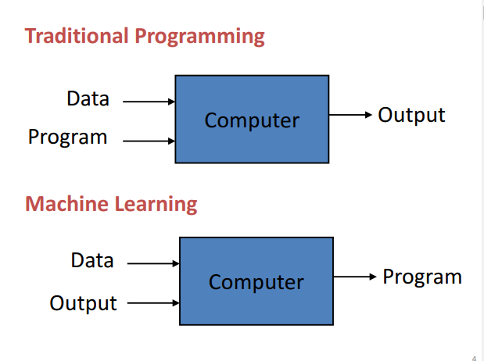

Slide 18
Types of Machine Learning:
Supervised Learning
Unsupervised Learning
Semi supervised Learning
Reinforcement Learning

Slide 19
Classification is the task of assigning a class label to an input pattern. The class label indicates one of a given set of classes. The classification is carried out with the help of a model obtained using a learning procedure. According to the type of learning used, there are two categories of classification. supervised learning and unsupervised learning.
Supervised learning makes use of a set of examples which already have the class labels assigned to them.
Unsupervised learning attempts to find inherent structures in the data.
Semi-supervised learning makes use of a small number of labeled data and a large number of unlabeled data to learn the classifier.

Slide 20
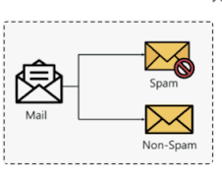
1. Supervised Learning
Supervised learning: classification is seen as supervised learning from examples.
Supervision: The data (observations, measurements, etc.) are labeled with pre-defined classes. It is like that a “teacher” gives the classes (supervision).
It is called supervised learning because the process of an algorithm learning from the training dataset can be thought of as a teacher supervising the learning process.
Test data are classified into these classes too.
Example: Classify the mails as span or non span based on redecided parameters.

Slide 21
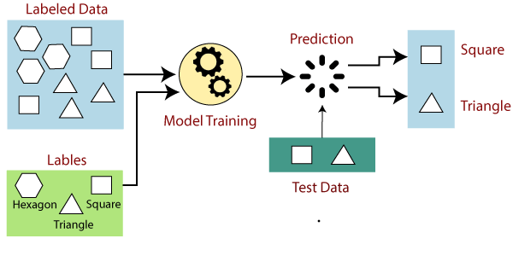
Supervised Learning
The aim of a supervised learning algorithm is to find a mapping function to map the input variable(x) with the output variable(y).
In the real-world, supervised learning can be used for Risk Assessment, Image classification, Fraud Detection, spam filtering, etc.

Slide 22
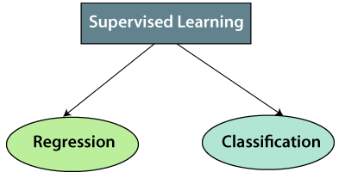
Types of supervised Machine learning Algorithms:
Supervised learning can be further divided into two types of problems:

Slide 23
Regression
Regression algorithms are used if there is a relationship between the input variable and the output variable. It is used for the prediction of continuous variables, such as Weather forecasting, Market Trends, etc.
Below are some popular Regression algorithms which come under supervised learning:
Linear Regression
Regression Trees
Non-Linear Regression
Bayesian Linear Regression
Polynomial Regression

Slide 24
Classification
Classification algorithms are used when the output variable is categorical, which means there are two classes such as Yes-No, Male-Female, True-false, etc.
Some of the Classification algorithms which come under supervised learning: are:
Random Forest
Decision Trees
Logistic Regression
Support vector Machines

Slide 25
Regression vs classification
Regression models are used to predict a continuous value.
Predicting prices of a house given the features of house like size, price etc is one of the common examples of Regression. It is a supervised technique.
Classification applied on discrete values.
Example: age vs. height., temperature of a city, house price

Slide 26

Regression vs classification

Slide 27
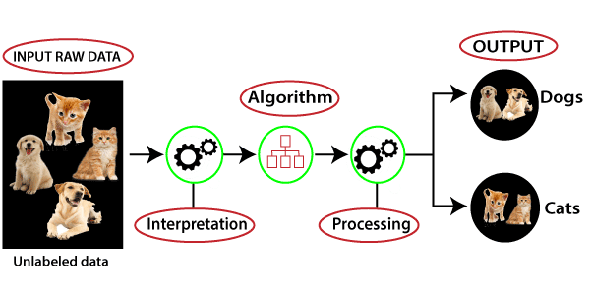
2. Unsupervised learning
Unsupervised learning (clustering)
Class labels of the data are unknown.
Given a set of data, the task is to establish the existence of classes or clusters in the data.
Unsupervised learning is a type of machine learning in which models are trained using unlabeled dataset and are allowed to act on that data without any supervision.

Slide 28
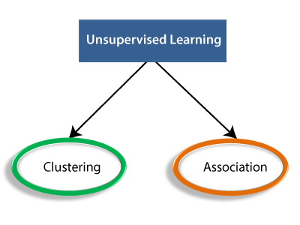
Types of unsupervised Algorithm

Slide 29
Clustering: Clustering is a method of grouping the objects into clusters such that objects with most similarities remains into a group and has less or no similarities with the objects of another group.
Association: An association rule is an unsupervised learning method which is used for finding the relationships between variables in the large database. It determines the set of items that occurs together in the dataset. Association rule makes marketing strategy more effective. Such as people who buy X item (suppose a bread) are also tend to purchase Y (Butter/Jam) item. A typical example of Association rule is Market Basket Analysis.

Slide 30

Unsupervised Learning algorithms:
Below is the list of some popular unsupervised learning algorithms:
K-means clustering
KNN (k-nearest neighbors)
Hierarchal clustering
Anomaly detection
Neural Networks
Principle Component Analysis
Independent Component Analysis
Apriori algorithm
Singular value decomposition

Slide 31


Supervised Learning | Unsupervised Learning
Supervised learning algorithms are trained using labeled data. | Unsupervised learning algorithms are trained using unlabeled data.
Supervised learning model takes direct feedback to check if it is predicting correct output or not. | Unsupervised learning model does not take any feedback.
Supervised learning model predicts the output. | Unsupervised learning model finds the hidden patterns in data.
In supervised learning, input data is provided to the model along with the output. | In unsupervised learning, only input data is provided to the model.
The goal of supervised learning is to train the model so that it can predict the output when it is given new data. | The goal of unsupervised learning is to find the hidden patterns and useful insights from the unknown dataset.
Supervised learning needs supervision to train the model. | Unsupervised learning does not need any supervision to train the model.
Supervised learning can be categorized in Classification and Regression problems. | Unsupervised Learning can be classified in Clustering and Associations problems.

Slide 32
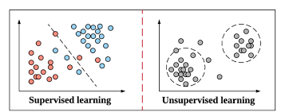
Supervised vs. unsupervised learning

Slide 33
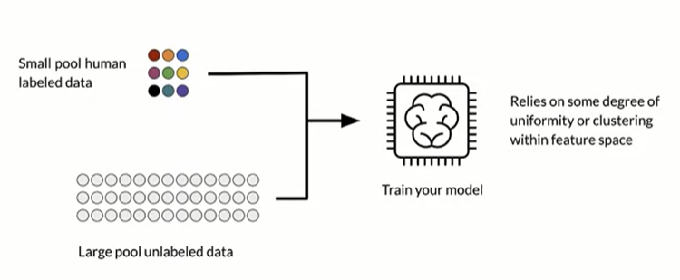
3. Semi supervised learning
It makes use of a small number of labeled data and a large number of unlabeled data to learn.
The model uses labeled data as an input to make inferences about the unlabeled data.

Slide 34
4. Reinforcement Learning
Reinforcement learning is a machine learning training method based on rewarding desired behaviors and/or punishing undesired ones.
In general, a reinforcement learning agent is able to perceive and interpret its environment, take actions and learn through trial and error.
Since there is no training data, machines learn from their own mistakes and choose the actions that lead to the best solution or maximum reward.

Slide 35
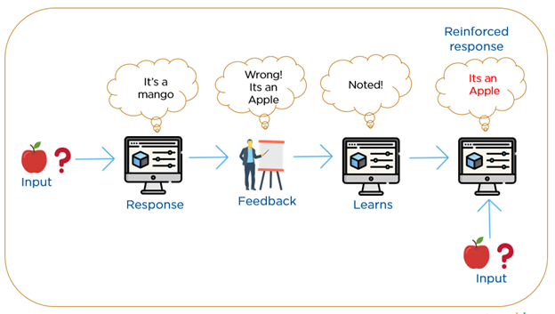
Reinforcement – Learning from the environment

Slide 36
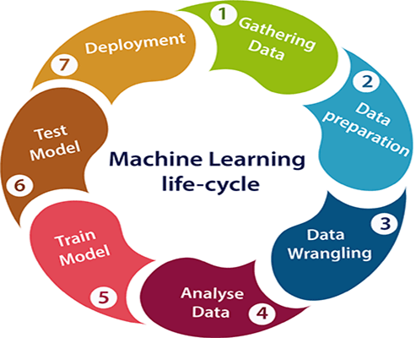
Life cycle of Machine learning

Slide 37
Learning
The classifier to be designed is built using input samples which is a mixture of all the classes.
The classifier learns how to discriminate between samples of different classes.
If the Learning is offline i.e. Supervised method then, the classifier is first given a set of training samples and the optimal decision boundary found, and then the classification is done.
If the learning is online then there is no teacher and no training samples (Unsupervised). The input samples are the test samples itself. The classifier learns and classifies at the same time.

Slide 38
Training and Testing data
Two types of data set in supervised classifier.
Training set : 70 to 80% of the available data will be used for training the system.
In Supervised classification Training data is the data you use to train an algorithm or machine learning model to predict the outcome you design your model to predict.
Testing set : around 20-30% will be used for testing the system. Test data is used to measure the performance, such as accuracy or efficiency, of the algorithm you are using to train the machine.
Testing is the measure of quality of your algorithm.
Many a times even after 80% testing, failures can be see during testing, reason being not good representation of the test data in the training set.
Unsupervised classifier does not use training data

Slide 39
Model Selection?
It is the process of selecting the optimal model from the set of candidate models, for a given data.
Data used in learning:
Training Set (Usually 60%)
Validation set – Cross Validation (20%) : Validated on different models on the same training set
Test data (20%) : Unseen data
Model Selection is finding the optimal model which minimizes both bias and variance.
Bias is the error during training and Variance is the error during testing

Slide 40

Features and classes
Properties or attributes used to classify the objects are called features.
A collection of “similar” (not necessarily same) objects are grouped together as one “class”.
For example:
All the above are classified as character T
Classes are identified by a label.
Most of the pattern recognition tasks are first done by humans and automated later.

Slide 41
Samples or patterns
The individual items or objects or situations to be classified will be referred as samples or patterns or data.
The set of data is called “Data Set”.

Slide 42
Pattern is anything which has a regular sequence of occurrence. A pattern can be either through visualization or it can be derived mathematically by applying algorithms.
Patterns include repeated trends in various forms of data
Examples : Speech pattern, print on clothes, design of outfits, jewelry pattern, Sound wave, tree species, fingerprint, face, barcode, QR-code, handwriting, or character image etc.
Pattern recognition is the process of recognizing patterns by using a machine learning algorithm. Pattern recognition can be defined as the classification of data based on knowledge already gained or on statistical information extracted from patterns and/or their representation. One of the important aspects of pattern recognition is its application potential.
Examples: Speech recognition, speaker identification, multimedia document recognition (MDR), automatic medical diagnosis.

Slide 43

The data inputs for pattern recognition can be words or texts, images, or audio files. Hence, pattern recognition is broader compared to computer vision that focuses on image recognition.
In a typical pattern recognition application, the raw data is processed and converted into a form that is convenient for a machine to use. Pattern recognition involves the classification and cluster of patterns.

Slide 44

Definition of Pattern Recognition
Pattern recognition is defined as the study of how machines can observe the environment, learn to distinguish various patterns of interest from their background, and make logical decisions about the categories of the patterns. During recognition, the given objects are assigned to a specific category.
In general, pattern recognition can be described as an information reduction, information mapping, or information labeling process.
In computer science, pattern recognition refers to the process of matching information already stored in a database with incoming data based on their attributes or features.

Slide 45
Input Data and Output Response for Various Applications
Task of Classification | Input Data | Output Response
Character Recognition | Optical Signals or Strokes | Name of the character
Speech Recognition | Acoustic Waveforms | Name of the word
Speaker Recognition | Voice | Name of the speaker
Weather Prediction | Weather Maps | Weather Forecasts
Medical Diagnosis | Symptoms | Disease
Stock Market Prediction | Financial News and Charts | Predicted Market ups and Downs

Slide 46
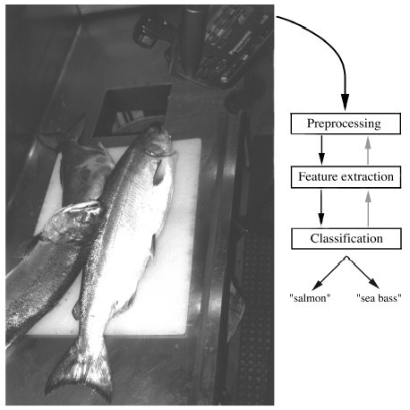
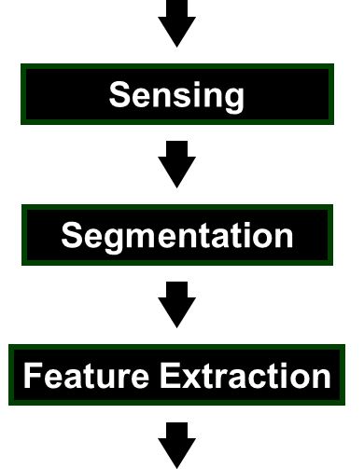
Image Processing Example
Sorting Fish: incoming fish are sorted according to species using optical sensing (sea bass or salmon?)
Problem Analysis:
set up a camera and take some sample images to extract features
Consider features such as length, lightness, width, number and shape of fins, position of mouth, etc.

Slide 47
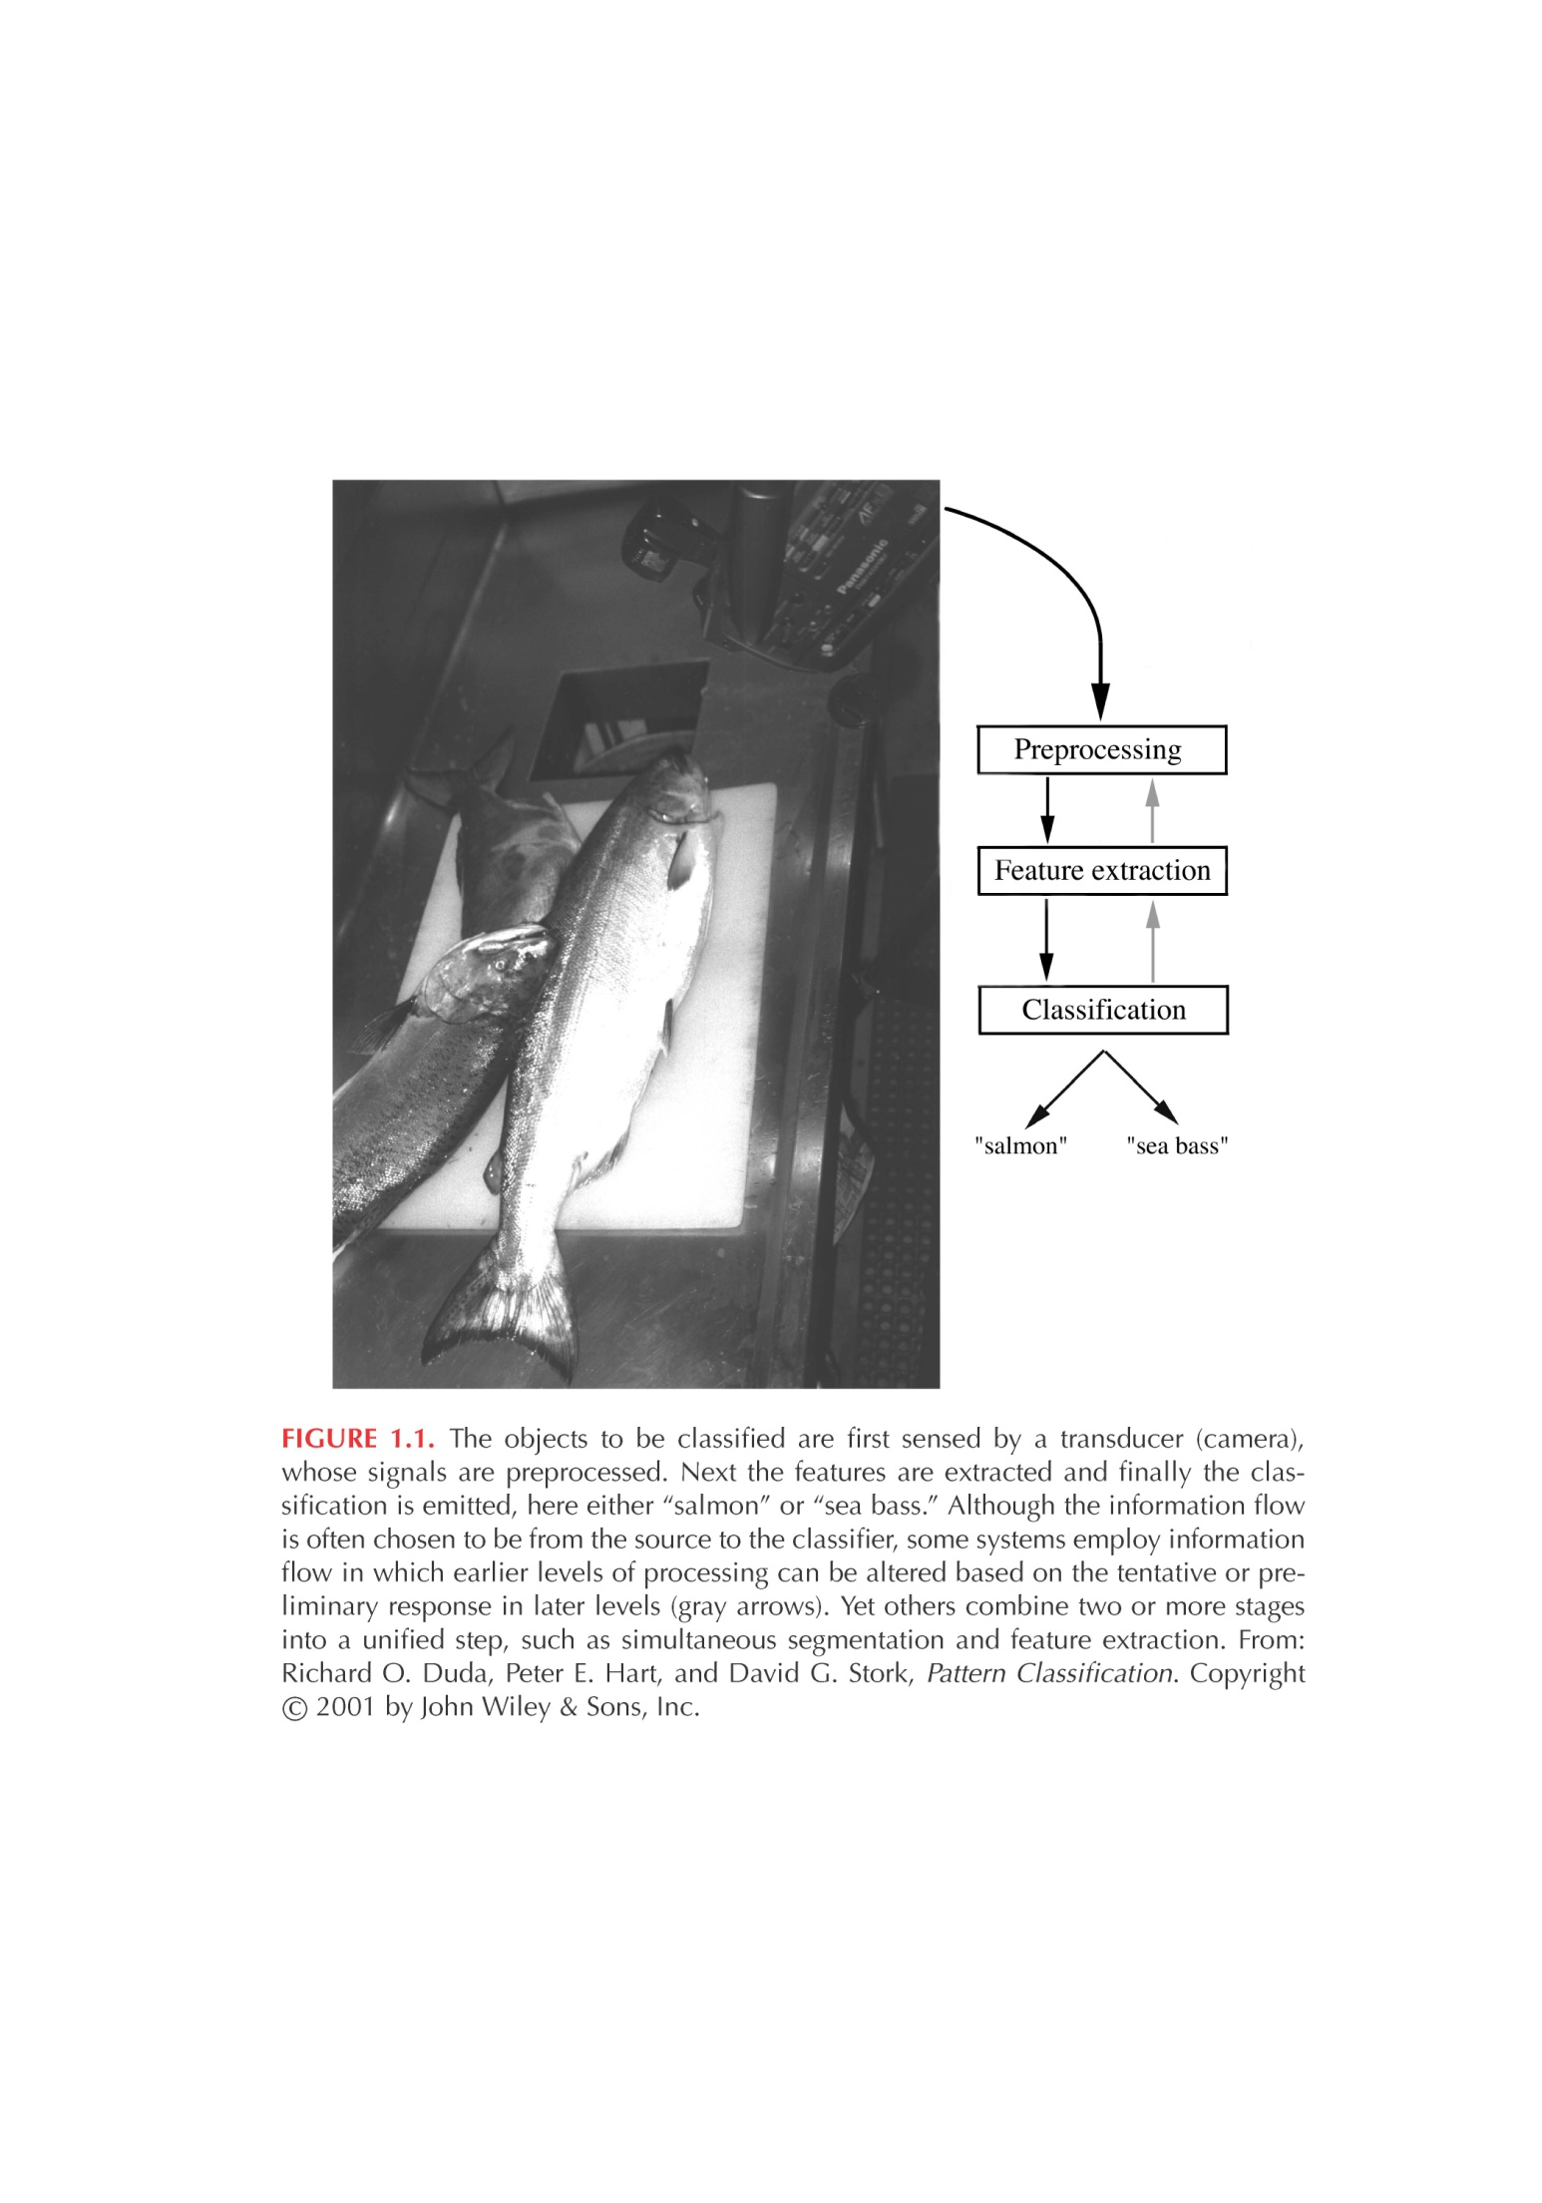
Preprocessing
A critical step for reliable feature extraction!
Examples:
Noise removal
Image enhancement
Separate touching
or occluding fish
Extract boundary of each fish

Slide 48
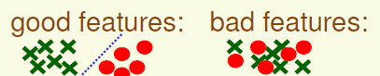
Feature Extraction
How to choose a good set of features?
Discriminative features
Invariant features (e.g., invariant to geometric transformations such as translation, rotation and scale)
Are there ways to automatically learn which features are best ?

Slide 49
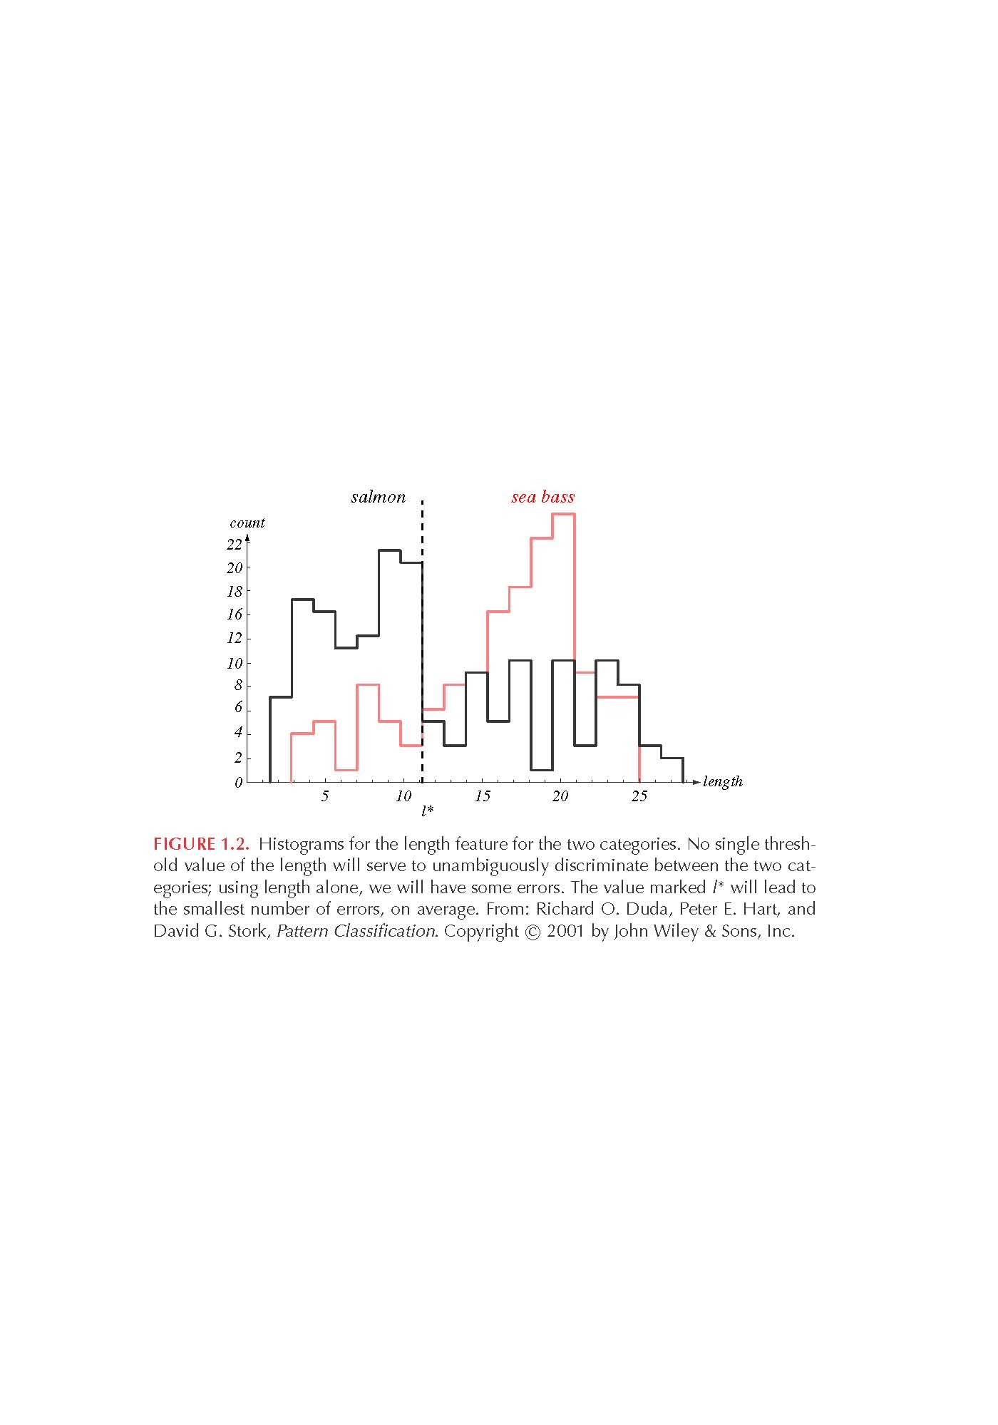
Feature Extraction (cont’d)
Histogram of “length”
Even though sea bass is longer than salmon on the average, there are many examples of fish where this observation does not hold.
threshold l*

Slide 50
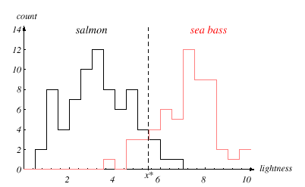
Add Another Feature
Lightness is a better feature than length because it reduces the misclassification error.
Can we combine features in such a way that we improve performance? (Hint: correlation)

Slide 51
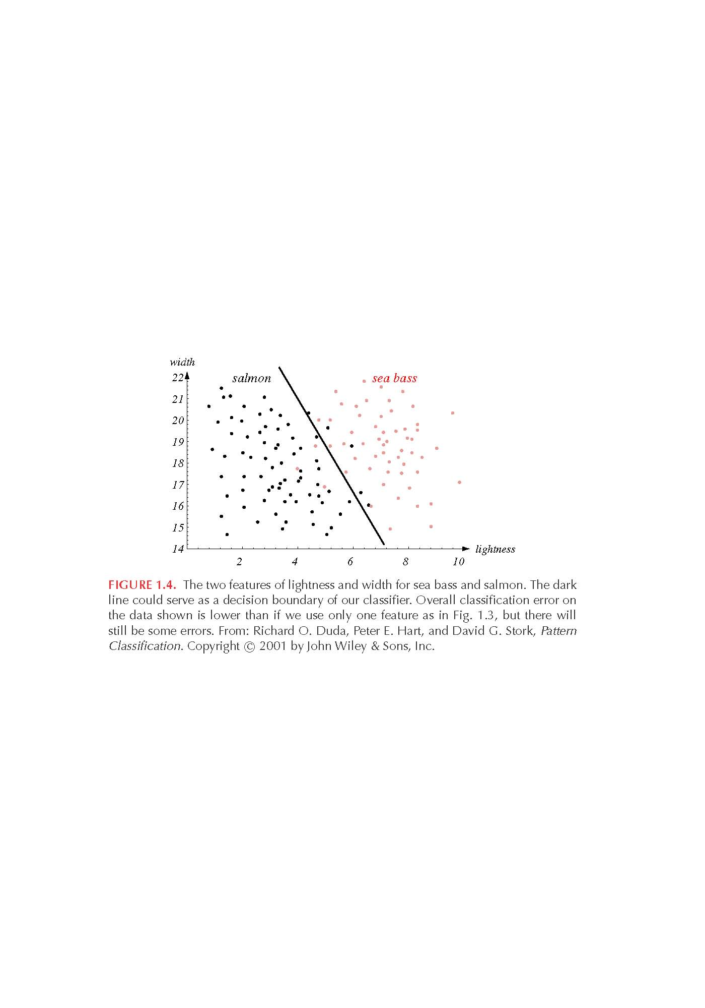
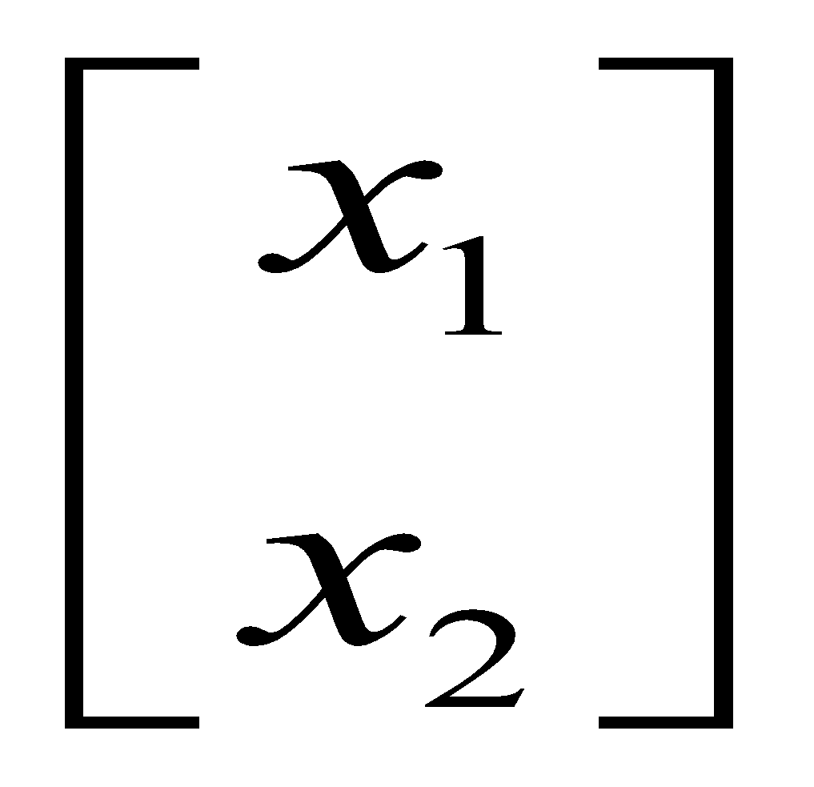
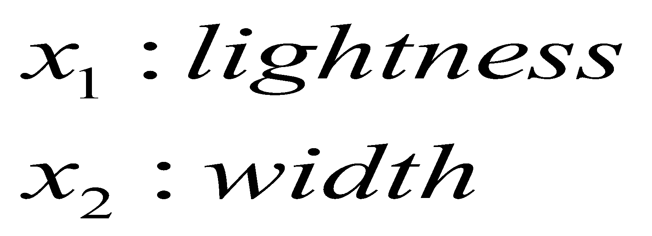
Multiple Features
To improve recognition accuracy, we might need to use more than one features.
Single features might not yield the best performance.
Using combinations of features might yield better performance.

Slide 52
If the feature space cannot be perfectly separated by a straight line, a more complex boundary might be used. (non-linear)
Alternatively a simple decision boundary such as straight line might be used even if it did not perfectly separate the classes, provided that the error rates were acceptably low.

Slide 53
Decision region and Decision Boundary
Our goal of Machine learning is to reach an optimal decision rule to categorize the incoming data into their respective categories
The decision boundary separates points belonging to one class from points of other
The decision boundary partitions the feature space into decision regions.
The nature of the decision boundary is decided by the discriminant function which is used for decision. It is a function of the feature vector.

Slide 54
Hyper planes and Hyper surfaces
For two category case, a positive value of discriminant function decides class 1 and a negative value decides the other.
If the number of dimensions is three. Then the decision boundary will be a plane or a 3-D surface. The decision regions become semi-infinite volumes
If the number of dimensions increases to more than three, then the decision boundary becomes a hyper-plane or a hyper-surface. The decision regions become semi-infinite hyperspaces.

Slide 55
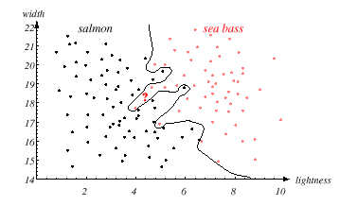
Decision Theory
Can we do better than a linear classifier?

Slide 56
Examples for Machine learning applications

Slide 57
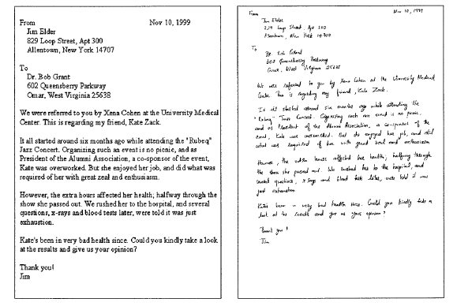
Handwriting Recognition

Slide 58
License Plate Recognition

Slide 59
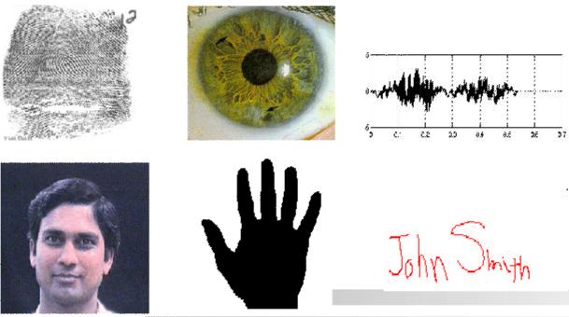
Biometric Recognition

Slide 60
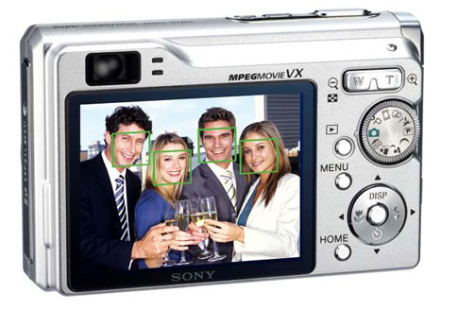
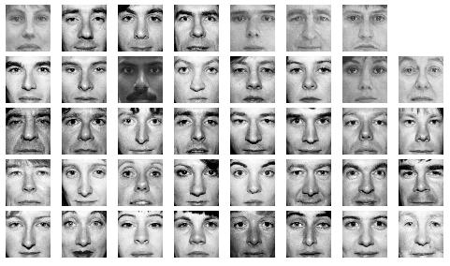
Face Detection/Recognition
Detection
Matching
Recognition

Slide 61
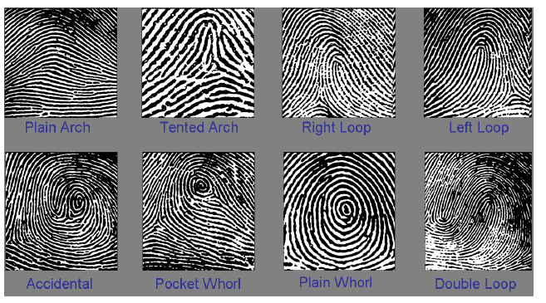
Fingerprint Classification
Important step for speeding up identification

Slide 62


Autonomous Systems
Obstacle detection and avoidance
Object recognition

Slide 63
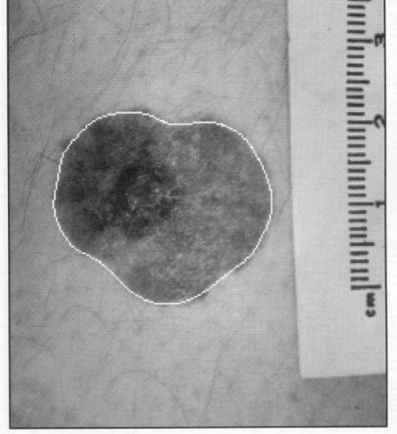
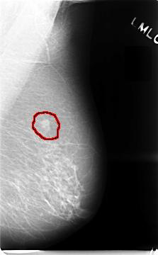
Medical Applications
Skin Cancer Detection
Breast Cancer Detection

Slide 64
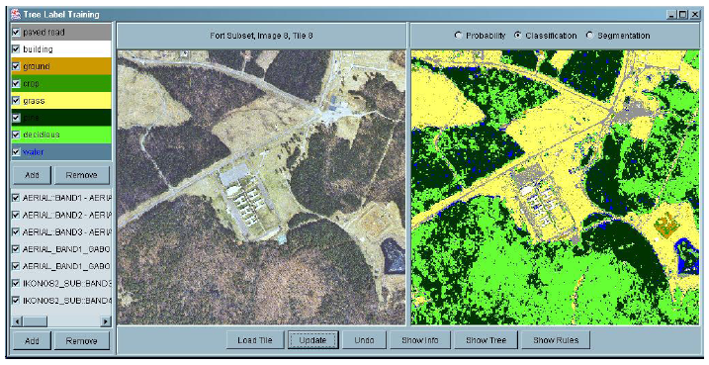
Land Cover Classification (using aerial or satellite images)
Many applications including “precision” agriculture.

Slide 65
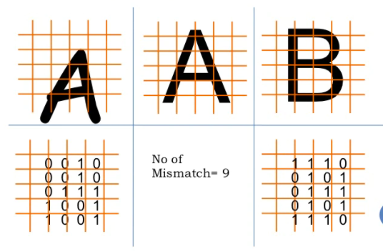
Statistical Decision Theory
Decision theory, in statistics, a set of quantitative methods for reaching optimal decisions.

Slide 66
Example for Statistical Decision Theory
Consider Hypothetical Basket ball Association:
The prediction could be based on the difference between the home team’s average number of points per game (apg) and the visiting team’s ‘apg’ for previous games.
The training set consists of scores of previously played games, with each home team is classified as winner or loser
Now the prediction problem is : given a game to be played, predict the home team to be a winner or loser using the feature ‘dapg’,
Where dapg = Home team apg – Visiting team apg

Slide 67
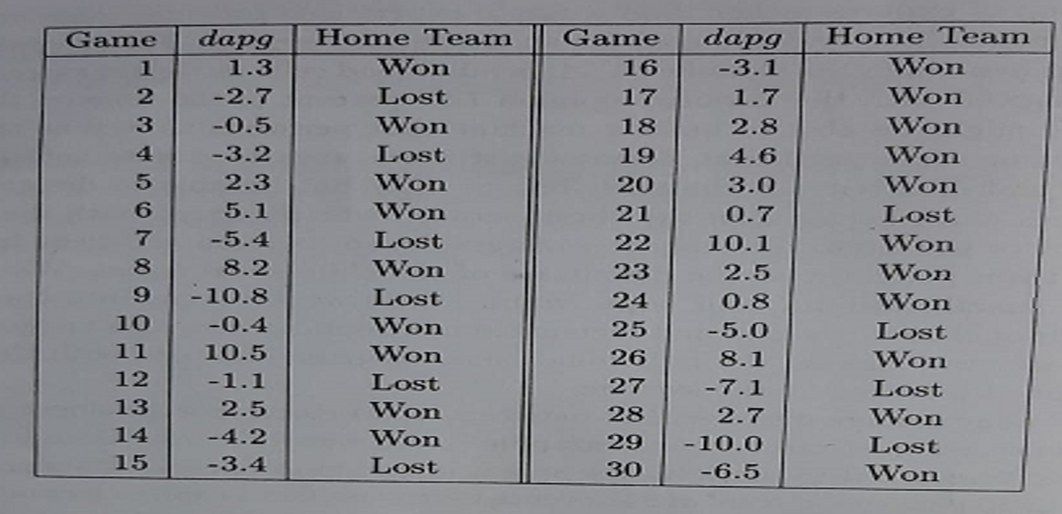
Data set of games showing outcomes, differences between average numbers of points scored and differences between winning percentages for the participating teams in previous games

Slide 68
The figure shown in the previous slide, lists 30 games and gives the value of dapg for each game and tells whether the home team won or lost.
Notice that in this data set the team with the higher apg usually wins.
For example in the 9th game the home team on average, scored 10.8 fewer points in previous games than the visiting team, on average and also the home team lost.
When the teams have about the same apgs, the outcome is less certain. For example, in the 10th game , the home team on average scored 0.4 fewer points than the visiting team, on average, but the home team won the match.
Similarly 12th game, the home team had an apg 1.1. less than the visiting team on average and the team lost.

Slide 69
Histogram of dapg
Histogram is a convenient way to describe the data.
To form a histogram, the data from a single class are grouped into intervals.
Over each interval rectangle is drawn, with height proportional to number of data points falling in that interval. In the example interval is chosen to have width of two units.
General observation is that, the prediction is not accurate with single feature ‘dapg’

Slide 70
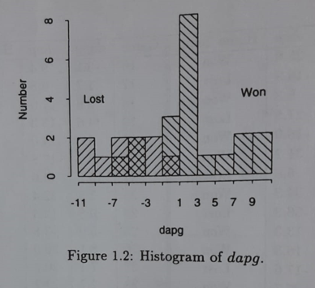


Lost
Won

Slide 71
Prediction
To predict normally a threshold value T is used.
‘dapg’ > T consider to be win
‘dapg’ < T consider to be lost
T is called decision boundary or threshold.
If T=-1, four samples in the original data are misclassified.
Here 3 winners are called losers and one loser is called winner.
If T=0.8, results in no samples from the loser class being misclassified as winner, but 5 samples from the winner class would be misclassified as loser.
IF T=-6.5, results no samples from the winner class being misclassified as losers, but 7 samples from the loser would be misclassified as winners.
By inspection, we see that when a decision boundary is used to classify the samples the minimum number of samples that are misclassified is four.
In the above observations, the minimum number of samples misclassified is 4 when T=0.8

Slide 72
Using Additional Feature dwp
To make it more accurate let us consider two features.
Additional features often increases the accuracy of classification.
Along with ‘dapg’ another feature ‘dwp’ is considered.
wp= winning percentage of a team in previous games
dwp = difference in winning percentage between teams
dwp = Home team wp – visiting team wp

Slide 73
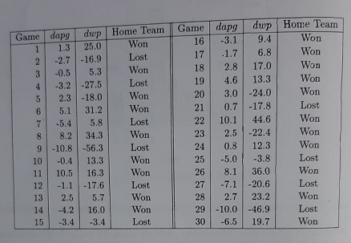
Data set of games showing outcomes, differences between average number of points scored and differences between winning percentages for the participating teams in previous games

Slide 74
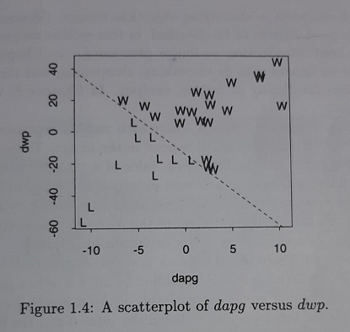
Now observe the results on a scatterplot
Each sample has a corresponding feature vector (dapg,dwp), which determines its position in the plot.
Note that the feature space can be classified into two decision regions by a straight line, called a linear decision boundary. (refer line equation). Prediction of this line is logistic regression.
If the sample lies above the decision boundary, the home team would be classified as the winner and it is below the decision boundary it is classified as loser.

Slide 75
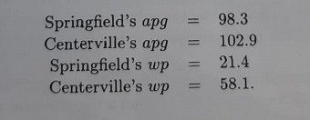
Prediction with two parameters.
Consider the following : springfield (Home team)
dapg= home team apg – visiting team apg = 98.3-102.9 = -4.6
dwp = Home team wp – visiting team wp = -21.4-58.1 = -36.7
Since the point (dapg, dwp) = (-4.6,-36.7) lies below the decision boundary, we predict that the home team will lose the game.

Slide 76
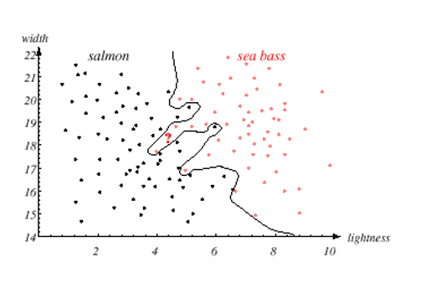
If the feature space cannot be perfectly separated by a straight line, a more complex boundary might be used. (non-linear)
Alternatively a simple decision boundary such as straight line might be used even if it did not perfectly separate the classes, provided that the error rates were acceptably low.

Slide 77
Having the model shown in previous slide, we can use it for any type of recognition and classification.
It can be
speaker recognition
Speech recognition
Image classification
Video recognition and so on…

Slide 78
It is now very important to learn:
Different techniques to extract the features
Then in the second stage, different methods to recognize the pattern and classify
Some of them use statistical approach
Few uses probabilistic model using mean and variance etc.
Other methods are - neural network, deep neural networks
Hyper box classifier
Fuzzy measure
And mixture of some of the above

Slide 79
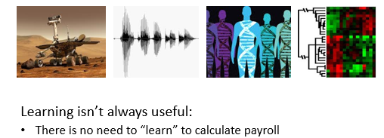
When do we use Machine Learning?
ML is used when:
Human expertise does not exist (navigating on Mars)
Humans can’t explain their expertise (speech recognition)
Models must be customized (personalized medicine)
Models are based on huge amounts of data (genomics)

Slide 80
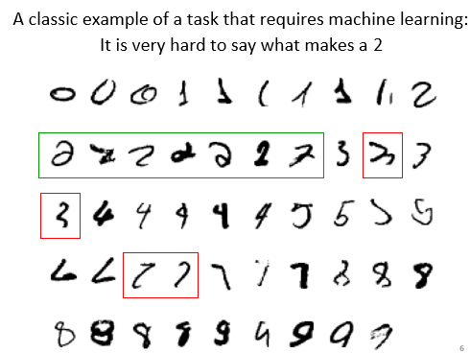

Slide 81
Probability: Introduction to probability Probabilities of Events

Slide 82
What is covered?
Basics of Probability
Combination
Permutation
Examples for the above
Union
Intersection
Complement

Slide 83
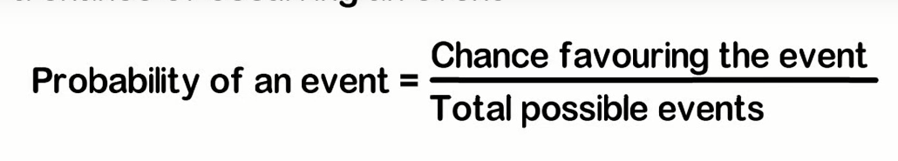
What is a probability
Probability is the branch of mathematics concerning numerical descriptions of how likely an event is to occur
The probability of an event is a number between 0 and 1, where, roughly speaking, 0 indicates that the event is not going to happen and 1 indicates event happens all the time.

Slide 84
Experiment
The term experiment is used in probability theory to describe a process for which the outcome is not known with certainty.
Example of experiments are:
Rolling a fair six sided die.
Randomly choosing 5 apples from a lot of 100 apples.

Slide 85
Event
An event is an outcome of an experiment. It is denoted by capital letter. Say E1,E2… or A,B….and so on
For example toss a coin, H and T are two events.
The event consisting of all possible outcomes of a statistical experiment is called the “Sample Space”. Ex: { E1,E2…}

Slide 86
Examples
Sample Space of Tossing a coin = {H,T}
Tossing 2 Coins = {HH,HT,TH,TT}

Slide 87
Random phenomena
Unable to predict the outcomes, but in the long-run, the outcomes exhibit statistical regularity.
Examples
Tossing a coin – outcomes S ={Head, Tail}
Unable to predict on each toss whether is Head or Tail.
In the long run can predict that 50% of the time heads will occur and 50% of the time tails will occur

Slide 88
Rolling a die – outcomes
S ={ , , , , , }
Unable to predict outcome but in the long run can one can determine that each outcome will occur 1/6 of the time.
Use symmetry. Each side is the same. One side should not occur more frequently than another side in the long run. If the die is not balanced this may not be true.

Slide 89
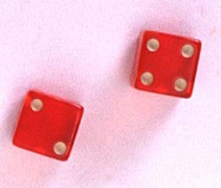
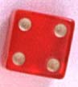
Example
The die toss:
Simple events: Sample space:
1
E₁
E₂
E₃
E₄
E₅
E₆
S ={E₁, E₂, E₃, E₄, E₅, E₆}
2
S
3
E₁
E₃
4
E₅
5
E₂
E₄
E₆
6

Slide 90
Frequency of an event
Frequency of occurrence is measured by:
(after the event has occurred)
If we let n get infinitely large,

Slide 91
The Probability of an Event
The probability of an event A measures “how often” A will occur. We write P(A).
P(A) must be between 0 and 1.
If event A can never occur, P(A) = 0. If event A always occurs when the experiment is performed, P(A) =1.
Then P(A) + P(not A) = 1.
So P(not A) = 1-P(A)
The sum of the probabilities for all simple events in S equals 1.

Slide 92
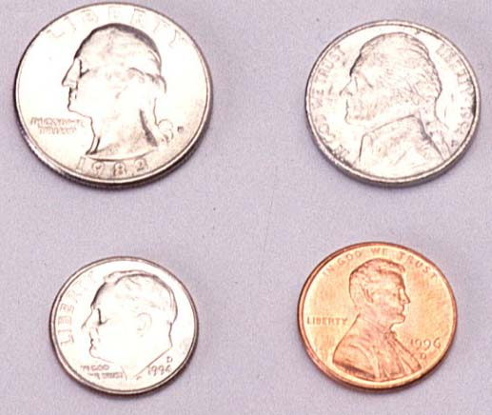
Example 1
Toss a fair coin twice. What is the probability of observing at least one head?
1st Coin 2nd Coin E_{i} P(E_{i})
H
HH
1/4
1/4
1/4
1/4
P(at least 1 head)
= P(E₁) + P(E₂) + P(E₃)
= 1/4 + 1/4 + 1/4 = 3/4
H
T
HT
H
T
T
H
T

Slide 93
Example 2
A bowl contains three colour Ms®, one red, one blue and one green. A child selects two M&Ms at random. What is the probability that at least one is red?
1st M&M 2nd M&M E_{i} P(E_{i})
m
RB
1/6
1/6
1/6
1/6
1/6
1/6
m
m
RG
P(at least 1 red)
= P(RB) + P(BR)+ P(RG) + P(GR)
= 4/6 = 2/3
m
BR
m
m
BG
m
m
GB
m
GR

Slide 94
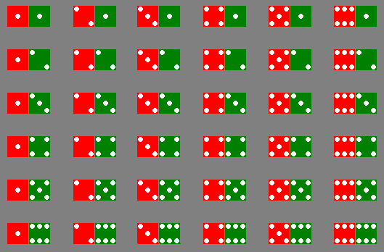
Example 3
The sample space of throwing a pair of dice is

Slide 95
Example 3
Event | Simple events | Probability
Dice add to 3 | (1,2),(2,1) | 2/36
Dice add to 6 | (1,5),(2,4),(3,3), (4,2),(5,1) | 5/36
Red die show 1 | (1,1),(1,2),(1,3), (1,4),(1,5),(1,6) | 6/36
Green die show 1 | (1,1),(2,1),(3,1), (4,1),(5,1),(6,1) | 6/36

Slide 96

Permutations
The number of ways you can arrange
n distinct objects, taking them r at a time is
Example: How many 3-digit lock combinations can we make from the numbers 1, 2, 3, and 4?
The order of the choice is important!

Slide 97
Examples
Example: A lock consists of five parts and can be assembled in any order. A quality control engineer wants to test each order for efficiency of assembly. How many orders are there?
The order of the choice is important!

Slide 98
It is required to seat 5 men and 4 women in a row so that the women occupy the even places. How many such arrangements are possible?
Solution:
Given: 5 men and 4 women
Total number of people = 9
The women occupy even places, which means they will be sitting in the 2nd, 4th, 6th and 8th places, whereas the men will be sitting in the 1st, 3rd, 5th, 7th and 9th places.
The number of arrangements in which 4 women can sit in 4 places = ⁴P₄ = 4!/(4 – 4)! = 4!/0! = 24/1 = 24
5 men can occupy 5 seats in 5 ways.
That means the number of ways they can be seated = ⁵P₅ = 5!/(5 – 5)! = 5!/0! = 120/1 = 120
Therefore, the total numbers of possible sitting arrangements = 24 × 120 = 2880

Slide 99
Combinations
The number of distinct combinations of n distinct objects that can be formed, taking them r at a time is
Example: Three members of a 5-person committee must be chosen to form a subcommittee. How many different subcommittees could be formed?
The order of
the choice is
not important!

Slide 100

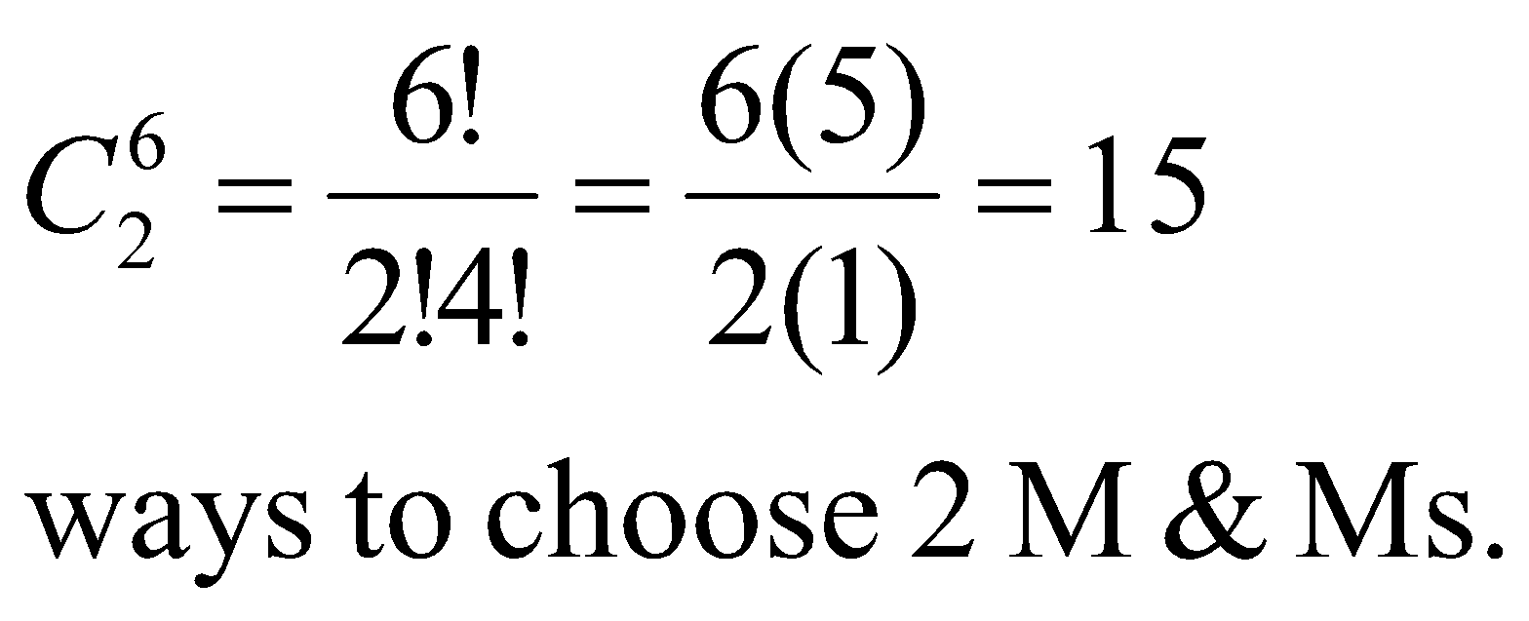
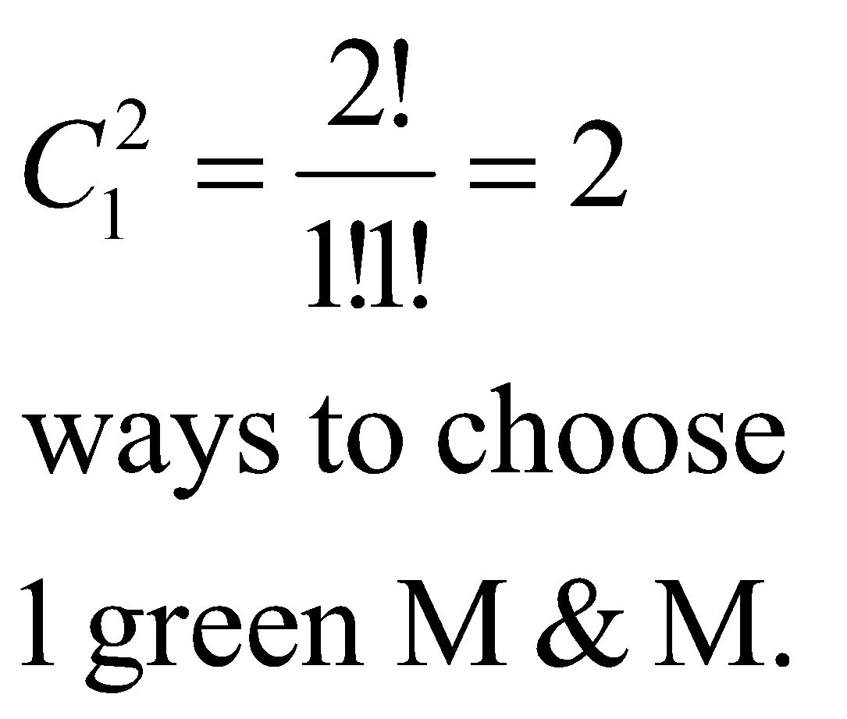
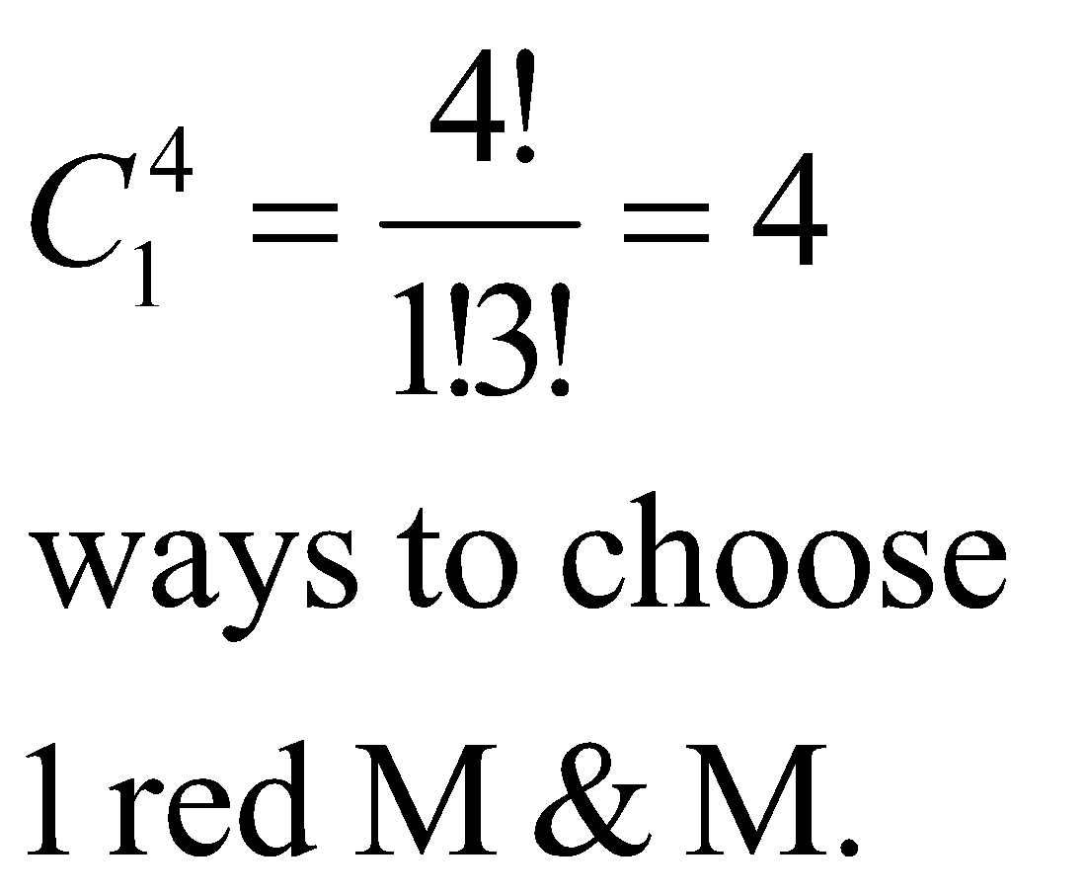
Example
m
m
m
m
m
m
A box contains six M&Ms®, four red
and two green. A child selects two M&Ms at random. What is the probability that exactly one is red?
The order of
the choice is
not important!
4 × 2 =8 ways to choose 1 red and 1 green M&M.
P(exactly one red) = 8/15

Slide 101
A team of four has to be selected from 6 boys and 4 girls. How many different ways a team can be selected if at least one boy must be there in the team?
Solution:
Combination of a four-member team with at least one boy are:
{(BGGG), (BBGG), (BBBG), (BBBB)}
Number of ways one boy and three girls can be selected = ⁶C₁ × ⁴C₃ = 6 × 4 = 24
Number of ways two boys and two girls can be selected = ⁶C₂ × ⁴C₂ = 15 × 6 = 90
Number of ways three boys and one girl can be selected = ⁶C₃ × ⁴C₁ = 20 × 4 = 80
Number of ways four boys can be selected = ⁶C₄ = 15
Total number of ways to form such a team = 24 + 90 + 80 + 15 = 209.

Slide 102
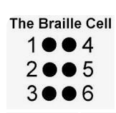
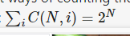
Is it combination or permutation?
Having 6 dots in a braille cell, how many different character can be made?
It is a problem of combination
C6,0+C 6,1 + C6,2 + C6,3+ C6,4+C6,5+ C6,6=1+6+15+20+15+6+1 = 64
(Why combination is used not permutation? : reason each dots is of same nature )
64 different characters can be made.
Where N is from 0 to 6. (It is the summation of combinations..)

Slide 103
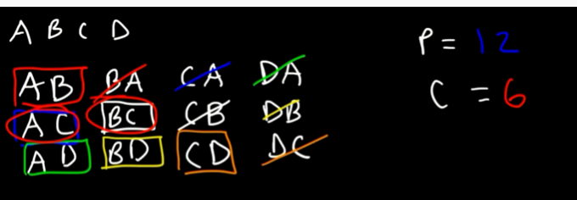
Having 4 characters, how may 2 character words can be formed: Permutation : P4,2= 12 Combination: C4,2 = 6 Remember Permutation is larger than combination

Slide 104


Summary:
So formula for Permutation is : (order is relevant)
Formula for Combination is: (Order is not relevant)

Slide 105
Event Relations

Slide 106
An Event , E
The event, E, is any subset of the sample space, S. i.e. any set of outcomes (not necessarily all outcomes) of the random phenomena
Venn diagram
S
E

Slide 107
The event, E, is said to have occurred if after the outcome has been observed the outcome lies in E.
S
E

Slide 108
Examples
Rolling a die – outcomes
S ={ , , , , , }
={1, 2, 3, 4, 5, 6}
E = the event that an even number is rolled
= {2, 4, 6}
={ , , }

Slide 109
Special Events
The Null Event, is also called as empty event represented by - φ
φ = { } = the event that contains no outcomes
The Entire Event, The Sample Space - S
S = the event that contains all outcomes

Slide 110
3 Basic Event relations
Union if you see the word or,
Intersection if you see the word and,
Complement if you see the word not.

Slide 111
Union
Let A and B be two events, then the union of A and B is the event (denoted by A∪B) defined by:
A ∪ B = {e| e belongs to A or e belongs to B}
A ∪ B
A
B

Slide 112
The event A ∪ B occurs if the event A occurs or the event and B occurs or both occurs.
A ∪ B
A
B

Slide 113

Intersection
Let A and B be two events, then the intersection of A and B is the event (denoted by A∩B) defined by:
A ∩ B = {e| e belongs to A and e belongs to B}
A ∩ B
A
B

Slide 114
The event A ∩ B occurs if the event A occurs and the event and B occurs .
A ∩ B
A
B

Slide 115
Complement
Let A be any event, then the complement of A (denoted by ) defined by:
= {e| e does not belongs to A}
A

Slide 116
The event occurs if the event A does not occur
A

Slide 117
Mutually Exclusive
Two events A and B are called mutually exclusive if:
A
B

Slide 118
If two events A and B are mutually exclusive then:
They have no outcomes in common. They can’t occur at the same time. The outcome of the random experiment can not belong to both A and B.
A
B

Slide 119
Rules of Probability Additive Rule Rule for complements

Slide 120
Additive rule (General case)
P[A ∪ B] = P[A] + P[B] – P[A ∩ B]
or
P[A or B] = P[A] + P[B] – P[A and B]

Slide 121

The additive rule (Mutually exclusive events) if A ∩ B = φ
P[A ∪ B] = P[A] + P[B]
i.e.
P[A or B] = P[A] + P[B]
if A ∩ B = φ
(A and B mutually exclusive)

Slide 122
When P[A] is added to P[B] the outcome in A ∩ B are counted twice
hence
P[A ∪ B] = P[A] + P[B] – P[A ∩ B]

Slide 123
Example: Bangalore and Mohali are two of the cities competing for the National university games. (There are also many others).
The organizers are narrowing the competition to the final 5 cities.
There is a 20% chance that Bangalore will be amongst the final 5.
There is a 35% chance that Mohali will be amongst the final 5 and
an 8% chance that both Bangalore and Mohali will be amongst the final 5.
What is the probability that Bangalore or Mohali will be amongst the final 5.

Slide 124
Solution: Let A = the event that Bangalore is amongst the final 5. Let B = the event that Mohali is amongst the final 5.
Given P[A] = 0.20, P[B] = 0.35, and P[A ∩ B] = 0.08
What is P[A ∪ B]? Note: “and” ≡ ∩, “or” ≡ ∪ .

Slide 125
Find the probability of drawing an ace or a spade from a deck of cards.
There are 52 cards in a deck; 13 are spades, 4 are aces.
Probability of a single card being spade is: 13/52 = 1/4.
Probability of drawing an Ace is : 4/52 = 1/13.
Probability of a single card being both Spade and Ace = 1/52.
Let A = Event of drawing a spade . Let B = Event drawing Ace.
Given P[A] =1/4, P[B] =1/13, and P[A ∩ B] = 1/52
P[A ∪ B] = 1/4 + 1/13 – 1/52

Slide 126


Rule for complements
or

Slide 127

Complement
Let A be any event, then the complement of A (denoted by ) defined by:
= {e| e does not belongs to A}
A

Slide 128
The event occurs if the event A does not occur
A

Slide 129


Logic:
A

Slide 130
What Is Conditional Probability?
Conditional probability is defined as the likelihood of an event or outcome occurring, based on the occurrence of a previous event or outcome.
Conditional probability is calculated by multiplying the probability of the preceding event by the updated probability of the succeeding, or conditional, event.
Bayes' theorem is a mathematical formula used in calculating conditional probability.

Slide 131


Definition
Suppose that we are interested in computing the probability of event A and we have been told event B has occurred.
Then the conditional probability of A given B is defined to be:
Similarly, P[B|A] = P[A ∩ B] /P[A]

Slide 132
From the previous two expressions
P[A ∩ B] = P[B].P[A|B]
And P[A ∩ B] = P[A].P[B|A]
Can also be used to calculate P[A ∩ B]
The Multiplication Rule
In many of the cases, P(A) may not depend on whether B has occurred. We say that the event A is independent of B if P(A) = P(A|B). An important consequence of the definition of independence is multiplication rule, which is obtained by substituting P(A) for P(A|B) in the above expressions
P[A ∩ B] = P[A].P[B] whenever A is independent of B

Slide 133
Rationale:
If we’re told that event B has occurred then the sample space is restricted to B.
The probability within B has to be normalized, This is achieved by dividing by P[B]
The event A can now only occur if the outcome is in A ∩ B. Hence the new probability of A is:
A
B
A ∩ B

Slide 134
An Example
The academy awards is soon to be shown.
For a specific married couple the probability that the husband watches the show is 80%, the probability that his wife watches the show is 65%, while the probability that they both watch the show is 60%.
If the husband is watching the show, what is the probability that his wife is also watching the show

Slide 135

Solution:
The academy awards is soon to be shown.
Let B = the event that the husband watches the show
P[B]= 0.80
Let A = the event that his wife watches the show
P[A]= 0.65 and P[A ∩ B]= 0.60

Slide 136

Another example
There are 100 Students in a class.
40 Students likes Apple
Consider this event as A, So probability of occurrence of A is 40/100 = 0.4
30 Students likes Orange.
Consider this event as B, So probability of occurrence of B is 30/100=0.3
Remaining Students does like either Apple nor Orange
20 Students likes Both Apple and Orange, So probability of Both A and B occurring is = A intersect B = 20/100 = 0.2
What is the probability of A in B, means what is the probability that A is occurring given B :

Slide 137

P(A|B) = 0.2/0.3 = 0.67
P(A|B) indicates that A occurring in the sample space of B.
Here we are not considering the entire sample space of 100 students, but only 30 students.
40
20
30

Slide 138
Example : Calculating the conditional probability of rain given that the biometric pressure is high.
Weather record shows that high barometric pressure (defined as being over 760 mm of mercury) occurred on 160 of the 200 days in a data set, and it rained on 20 of the 160 days with high barometric pressure. If we let R denote the event “rain occurred” and H the event “ High barometric pressure occurred” and use the frequentist approach to define probabilities.
P(H) = 160/200 = 0.8
and P(R and H) = 20/160 = 0.10
We can obtain the probability of rain given high pressure, directly from the data.
P(R|H) = 20/160 = 0.125
Using conditional probability
P(R|H) = P(R and H)/P(H) = 0.10/0.8 = 0.125.

Slide 139

Example : In my town, it's rainy one third of the days. Given that it is rainy, there will be heavy traffic with probability 1/2, and given that it is not rainy, there will be heavy traffic with probability 1/4. If it's rainy and there is heavy traffic, I arrive late for work with probability 1/2. On the other hand, the probability of being late is reduced to 1/8 if it is not rainy and there is no heavy traffic. In other situations (rainy and no traffic, not rainy and traffic) the probability of being late is 0.25. You pick a random day.
What is the probability that it's not raining and there is heavy traffic and I am not late?
What is the probability that I am late?
Given that I arrived late at work, what is the probability that it rained that day?

Slide 140


Slide 141
Let R be the event that it's rainy, T be the event that there is heavy traffic, and L be the event that I am late for work. As it is seen from the problem statement, we are given conditional probabilities in a chain format. Thus, it is useful to draw a tree diagram for this problem. In this figure, each leaf in the tree corresponds to a single outcome in the sample space. We can calculate the probabilities of each outcome in the sample space by multiplying the probabilities on the edges of the tree that lead to the corresponding outcome
The probability that it's not raining and there is heavy traffic and I am not late can be found using the tree diagram which is in fact applying the chain rule:
P(Rc∩T∩Lc) =P(Rc)P(T|Rc)P(Lc|Rc∩T)
=2/3⋅1/4⋅3/4
=1/8.

Slide 142
The probability that I am late can be found from the tree. All we need to do is sum the probabilities of the outcomes that correspond to me being late. In fact, we are using the law of total probability here.
P(L) =P(R and T and L)+P(R and Tc and L) + P(Rc and T and L) + P(Rc and Tc and L)
=1/12+1/24+1/24+1/16
=11/48.
c. We can find P(R|L) using
P(R|L)=P(R∩L)/P(L)
We have already found P(L)=11/48 and we can find P(R∩L) similarly by adding the probabilities of the outcomes that belong to R∩L.

Slide 143
In particular,
P(R∩L) =P(R,T,L)+P(R,Tc,L)
=1/12+1/24
=1/8
Thus we obtain
P(R|L) =P(R∩L)/P(L)
=(1/8)/(11/48)
=6/11.

Slide 144
Random Variables
Random variable takes a random value, which is real and can be finite or infinite and it is generated out of random experiment.
The random value is generated out of a function.
Example: Let us consider an experiment of tossing two coins.
Then sample space is S= { HH, HT, TH, TT}
Given X as random variable with condition: number of heads.
X(HH) =2
X(HT) =1
X(TH) =1
X(TT) = 0

Slide 145


Slide 146
The distribution function for the number of heads from two flips of a coin.
The random variable k is defined to be the total number of heads that occur when a fair coin is flipped two times.
This random variable can have only 3 values 0,1,2, so it is discrete.
Distribution function is (T, T), (T, H), (H, T), (H, H)
k | P(k)
0 | 1/4
1 | 2/4
2 | 1/4

Slide 147



In general, a probability distribution function takes the following form.
The table shows the pmf of a dataset. Areas under pmf graphs correspond to probability
For example: Pr(X = 2) = shaded rectangle = height × base

Slide 148
Two types of random variables
Discrete random variables (countable set of possible outcomes)
Continuous random variable (unbroken chain of possible outcomes)
A discrete random variable is described by its distribution function which lists for each outcome x the probability P(x) of x.
Discrete random variables are understood in terms of their probability mass function (pmf)
pmf ≡ a mathematical function that assigns probabilities to all possible outcomes for a discrete random variable.

Slide 149
Two types of random variables
Discrete random variables
Continuous random variable

Slide 150
Discrete random variables
If the variable value is finite or infinite but countable, then it is called discrete random variable.
Example of tossing two coins and to get the count of number of heads is an example for discrete random variable.
Sample space of real values is fixed.

Slide 151
Discrete random variables
If the variable value is finite or infinite but countable, then it is called discrete random variable.
Example : Tossing two coins or ice cream purchase in the following slides are examples for discrete random variable.

Slide 152


Example: Random variable

Slide 153



Slide 154
Probability of customers purchasing more than 3 ice creams:
Consider P(X), where X>3
Then it will be sum of P(X=4) + P(X=5) + P(X=6)= 0.04+0.04+0.02=0.10
10 percent of the customers will purchase more than 3 ice creams.
However Summation of i=1 to n P(Xi)=1

Slide 155
Continuous Random Variable
If the random variable values lies between two certain fixed numbers then it is called continuous random variable. The result can be finite or infinite.
Sample space of real values is not fixed, but it is in a range.
If X is the random value and it’s values lies between a and b then,
It is represented by : a <= X <= b
Example: Temperature, age, weight, height…etc. ranges between specific range.
Here the values for the sample space will be infinite

Slide 156
Probability distribution
Frequency distribution is a listing of the observed frequencies of all the output of an experiment that actually occurred when experiment was done.
Where as a probability distribution is a listing of the probabilities of all possible outcomes that could result if the experiment were done. (distribution with expectations).

Slide 157
Broad classification of Probability distribution
Discrete probability distribution
Binomial distribution
Poisson distribution
Continuous Probability distribution
Normal distribution

Slide 158
Discrete Probability Distribution: Binomial Distribution
A binomial distribution can be thought of as simply the probability of a SUCCESS or FAILURE outcome in an experiment or survey that is repeated multiple times. (When we have only two possible outcomes)
Example, a coin toss has only two possible outcomes: heads or tails and taking a test could have two possible outcomes: pass or fail.

Slide 159
Assumptions of Binomial distribution (It is also called as Bernoulli’s Distribution)
Assumptions:
Random experiment is performed repeatedly with a fixed and finite number of trials. The number is denoted by ‘n’
There are two mutually exclusive possible outcome on each trial, which are know as “Success” and “Failure”. Success is denoted by ‘p’ and failure is denoted by ‘q’. and p+q=1 or q=1-p.
The outcome of any give trail does not affect the outcomes of the subsequent trail. That means all trials are independent.
The probability of success and failure (p&q) remains constant for all trials. If it does not remain constant then it is not binomial distribution. For example tossing a coin the probability of getting head or getting a red ball from a pool of colored balls, here every time after the ball is taken out it is again replaced to the pool.
With this assumption let see the formula

Slide 160



Formula for Binomial Distribution
OR
P(X=r) =
Where P is success and
q is failure

Slide 161

Binomial distribution, generally
Note the general pattern emerging 🡪 if you have only two possible outcomes (call them 1/0 or yes/no or success/failure) in n independent trials.
Total number of successes X obtained in trials is called a binomial random variable
then the probability of exactly X “successes” P(x) is as follows
n = number of trials
P(x) =
1-p = probability of failure
X = # successes out of n trials
p = probability of success

Slide 162
Binomial Probability Distribution
A fixed number of observations (trials), n
e.g., 15 tosses of a coin; 20 patients; 1000 people surveyed
A binary outcome
e.g., head or tail in each toss of a coin; disease or no disease
Generally called “success” and “failure”
Probability of success is p, probability of failure is 1 – p
Constant probability for each observation
e.g., Probability of getting a tail is the same each time we toss the coin

Slide 163
Consider a pen manufacturing company
10% of the pens are defective
(i)Find the probability that at least 2 pens are defective in a box of 12
So n=12,
p=10% = 10/100 = 1/10
q= (1-q) =90/100 = 9/10
X>=2
P(X>=2) = 1- [P(X<2)]
= 1-[P(X=0) +P(X=1)]

Slide 164


Binomial Distribution: Illustration with example
Consider a pen manufacturing company
10% of the pens are defective
(i)Find the probability that exactly 2 pens are defective in a box of 12
So n=12,
p=10% = 10/100 = 1/10
q= (1-q) =90/100 = 9/10
X=2

Slide 165
Binomial distribution: Another example
If I toss a coin 20 times, what’s the probability of getting exactly 10 heads?

Slide 166

Binomial distribution: example
If I toss a coin 20 times, what’s the probability of getting of getting 2 or fewer heads?

Slide 167
The Binomial Distribution: another example
Say 40% of the class is female.
What is the probability that 6 of the first 10 students walking in will be female?

Slide 168
Continuous Random Variable
If the random variable values lies between two certain fixed numbers then it is called continuous random variable. The result can be finite or infinite.
If X is the random value and it’s values lies between a and b then,
It is represented by : a <= X <= b
Example: Temperature, age, weight, height…etc. ranges between specific range.

Slide 169
Continuous Probability Distributions
When the random variable of interest can take any value in an interval, it is called continuous random variable.
Every continuous random variable has an infinite, uncountable number of possible values (i.e., any value in an interval).
Examples Temperature on a given day, Length, height, intensity of light falling on a given region.
The length of time it takes a truck driver to go from New York City to Miami.
The depth of drilling to find oil.
The weight of a truck in a truck-weighing station.
The amount of water in a 12-ounce bottle.
For each of these, if the variable is X, then x>0 and less than some maximum value possible, but it can take on any value within this range

Slide 170





Slide 171



Slide 172
Continuous random variable differs from discrete random variable. Discrete random variables can take on only a finite number of values or at most a countable infinity of values.
A continuous random variable is described by Probability density function. This function is used to obtain the probability that the value of a continuous random variable is in the given interval.

Slide 173
Continuous Uniform Distribution
For Uniform distribution, f(x) is constant over the possible value of x.
Area looks like a rectangle.
For the area in continuous distribution we need to do integration of the function.
However in this case it is the area of rectangle.
Example to time taken to wash the cloths in a washing machine. (for a standard condition)

Slide 174




Slide 175
NORMAL DISTRIBUTION
The most often used continuous probability distribution is the normal distribution; it is also known as Gaussian distribution.
Its graph called the normal curve is the bell-shaped curve.
Such a curve approximately describes many phenomenon occur in nature, industry and research.
Physical measurement in areas such as meteorological experiments, rainfall studies and measurement of manufacturing parts are often more than adequately explained with normal distribution.

Slide 176
NORMAL DISTRIBUTION
The normal (or Gaussian) distribution, is a very commonly used (occurring) function in the fields of probability theory, and has wide applications in the fields of:
Pattern Recognition;
Machine Learning;
Artificial Neural Networks and Soft computing;
Digital Signal (image, sound , video etc.) processing
Vibrations, Graphics etc.

Slide 177


The probability distribution of the normal variable depends upon the two parameters 𝜇 and 𝜎
The parameter μ is called the mean or expectation of the distribution.
The parameter σ is the standard deviation; and variance is thus σ^2.
Few terms:
Mode: Repeated terms
Median : middle data (if there are 9 data, the 5th one is the median)
Mean : is the average of all the data points
SD- standard Deviation, indicates how much the data is deviated from the mean.
Low SD indicates that all data points are placed close by
High SD indicates that the data points are distributed and are not close by.
SD given by the formula (S)
Where S is sample SD
If you want population SD, represented by
and then divide by N not N-1

Slide 178
The probability distribution of the normal variable depends upon the two parameters 𝜇 and 𝜎
The parameter μ is called the mean or expectation of the distribution.
The parameter σ is the standard deviation; and variance is thus σ^2.
standard deviation is a measure of the amount of variation or dispersion of a set of values.
A low standard deviation indicates that the values tend to be close to the mean ( expected value) of the set,
a high standard deviation indicates that the values are spread out over a wider range.
The density of the normal variable 𝑥 with mean 𝜇 and variance 𝜎² is
𝑓 𝑥 =
1
_{𝑒}−
(𝑥−𝜇)²
ൗ
−∞ < 𝑥 < ∞
2𝜎
2
𝜎 2𝜋
where 𝜋 = 3.14159 … and 𝑒 = 2.71828 … . ., the Naperian constant
f(x)
𝜎

Slide 179


The Normal distribution
(mean μ, standard deviation σ)
1
₋( x−μ )²
f ( x) =
e
2σ ²
2πσ
A plot of normal distribution (or bell-shaped curve) where each band has a width of 1 standard deviation – See also: 68–95– 99.7 rule.
Standard Normal Distribution : In the above equation probability is computed for particular value of x. If you want a range then it has to be integrated.

Slide 180

For Standard Normal distribution:
For standard normal distribution, the area under the given range is given by:

Slide 181


Slide 182


Slide 183

Problem: Normal distribution
Consider an electrical circuit in which the voltage is normally distributed with mean 120 and standard deviation of 3. What is the probability that the next reading will be between 119 and 121 volts?

Slide 184


Slide 185

Another problem

Slide 186

Difference between PDF and PMF

Slide 187
Joint Distributions and Densities
The joint random variables (x,y) signifies that , simultaneously, the first feature has the value x and the second feature has the value y.
If the random variables x and y are discrete, the joint distribution function of the joint random variable (x,y) is the probability of P(x,y) that both x and y occur.

Slide 188

Joint distribution in continuous random variable
If x and y are continuous, then the probability density function is used over the region R, where x and y is applied is used.
It is given by:
Where the integral is taken over the region R. This integral represents a volume in the xyp-space.

Slide 189

Probability distributions can be used to describe the population, just as we described samples .
Shape: Symmetric, skewed, mound-shaped…
Outliers: unusual or unlikely measurements
Center and spread: mean and standard deviation. A population mean is called μ and a population standard deviation is called σ.
Let x be a discrete random variable with probability distribution p(x). Then the mean, variance and standard deviation of x are given as

Slide 190


Variance, continuous
Discrete case:
Continuous case?:

Slide 191
Moments of Random Variables
Moments are very useful in statistics because they tell us much about our data.
In mathematics, the moments of a function are quantitative measures related to the shape of the function's graph.
The “moments” of a random variable (or of its distribution) are expected values of powers or related functions of the random variable.
If the function represents mass, then the first moment is the center of the mass, and the second moment is the rotational inertia. The mathematical concept is closely related to the concept of moment in physics.
If the function is a probability distribution, then there are four commonly used moments in statistics
The first moment is the expected value - measure of center of the data
The second central moment is the variance - spread of our data about the mean
The third standardized moment is the skewness - the shape of the distribution
The fourth standardized moment is the kurtosis - measures the peakedness or flatness of the distribution.

Slide 192

Computing Moments for population

Slide 193


Moment 3: To know the Skewness
In positive Skewness,
Mean is > median
and
Median>mode
And it is reverse in case of –ve skewness

Slide 194

Moment 4 : To know the Kurtosis

Slide 195


Slide 196

D

Slide 197

Normal Distribution
Consider an example of x values:
4,5,5,6,6,6,7,7,8
Mode, Median and mean all will be equal
= Mode is 6
= Median is 6
= Mean is also 6

Slide 198

Positive Skew
Consider an example of x values:
5,5,5,6,6,7,8,9,10
(It is an example for Normal Distribution)
= Mode is 5
= Median is 6
= Mean is also 6.8

Slide 199

+ve skew

Slide 200

-ve skew

Slide 201
The “moments” of a random variable (or of its distribution) are expected values of powers or related functions of the random variable.
In particular, the first moment is the mean, µX = E(X).
μ_{k} = E ( X )
k
⎧ ∑ x^{k} p ( x)
if X is discrete
₌ ⎪
x
⎨ ∞
⎪ ∫ x^{k} f ( x) dx
if X is continuous
⎪⎩-∞
The mean is a measure of the “center” or “location” of a distribution.
The k^{th} moment of X.

Slide 202




Let X be a discrete random variable having support Rx = <1, 2> and the pmf is
using this compute Solution:
A central moment is a moment of a probability distribution of
random variables about the random variables Mean (Expected Value).
The k^{th} central moment of X

Slide 203
Formula for Computing Kth Central moment of Random variable
The k^{th} central moment of X

Slide 204
Expected Values of Discrete Random Variables
The variance of a discrete random variable x is
The standard deviation of a discrete random variable x is

Slide 205
Let X be a discrete random variable having support x = <1, 2> and the pmf is
Using this compute mean (first order moment)
First order moment is the mean.
Solution:

Slide 206


Example : Let X be a discrete random variable having support Rx = <1, 2, 3> and pmf is as listed below
The third moment of can be computed as shown:

Slide 207

For example computation of 3rd Order moment
The third central moment of can be computed as follows:
Here X value is 1 and 2 and Probability is ¾ and ¼ respectively. Consider Mean is 5/4

Slide 208
Estimation of Parameters from Samples
There are 3 kinds of estimates for these parameters:
Method of moments estimates
Maximum likelihood estimates
Unbiased estimates.

Slide 209



Estimation of Parameters from samples: Method of moments
To estimate parameters using methods of moments, ‘n’ independent samples or patterns x1,x2,x3…xn are collected from random variable x, which may be continuous or discrete.
Randomly choose one of these samples in the data set,
let its value to be a new discrete random variable x’ called the empirical random variable, which takes on of these values x1,x2,x3…xn.
Each with a probability 1/n.
Compute the sample mean and sample variance using the formula
The method of moments can also be used to compute covariance :
covariance is a measure of the relationship between two random variables.
The metric evaluates how much – to what extent – the variables change together. In other words, it is essentially a measure of the variance between two variables.

Slide 210
Maximum Likelihood Estimates:
Maximum likelihood estimation is a method that determines values for the parameters of a model. The parameter values are found such that they maximise the likelihood that the process described by the model produced the data that were actually observed.
To compute maximum likelihood estimate, choose parameter (or set of parameters) that maximises the joint distribution function or multivariate density function for the entire data set when it is evaluated at the sample points x1,x2,x3…xn.

Slide 211
End of Unit 1

